Slide 1
Unit 1
Introduction to AIX

Slide 2
Unit Objectives
After completing this unit, you should be able to:
Describe the major components of an AIX system
Describe the major topics in this course
Provide the value of these topics when working in an AIX environment

Slide 3
AIX Operating System
Interface to hardware
AIX Kernel
Manages processes
Process 1
User sarah
Process 2
Process 3
User fred
Process 4
...

Slide 4
Working on an AIX System (1 of 2)
Log in to AIX
Shell
$ command1
$ command2
Working with the Shell
$ who
$ mail sarah
Communicate with others
$ man mail
$ infocenter
Getting help

Slide 5

Working on an AIX System (2 of 2)
Disks
CD-ROM
Network
File System
Working with directories
DATA
Working with files
Protect
Copy, Move, Delete
Edit, Print
The vi editor is available on most UNIX platforms

Slide 6
Activity: Fill in the Blanks
K______
Interface to hardware
S_____
User's interface
F___
S______
Access to data

Slide 7
The Shell: User Interface to AIX
Executes user commands:
Command interpreter
Features:
Wildcards
Variables
...
Programming language
Shell
Customizable
Process control

Slide 8
Useful AIX Utilities
Search for specific files
Search for patterns in files
file1
Compare files and directories
Compress files

Slide 9
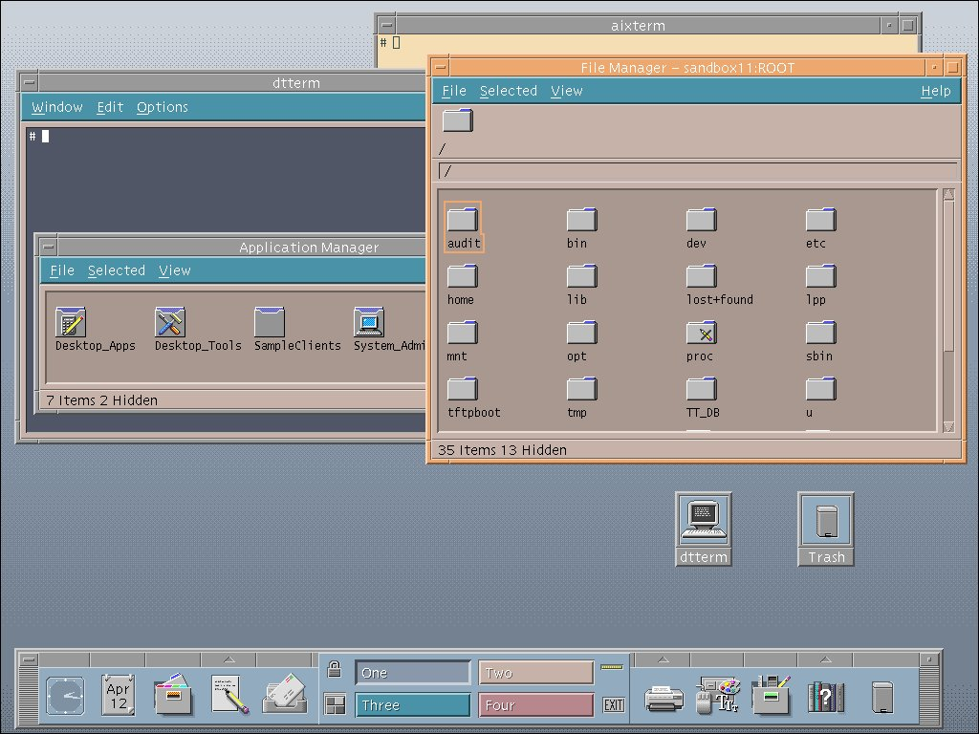
AIX Graphical User Interfaces
Windows
Mouse Pointer
Icons
AIX Windows
Common Desktop
Environment (CDE)

Slide 10
Checkpoint
Which part of the operating system interacts directly with the hardware?
Which part of the operating system does the user interact with?
  Shell
  Kernel
Which editor is available across most UNIX platforms?
Write down the names of two AIX graphical user interfaces:
True or false: AIX only supports file systems on hard disks.

Slide 11
Checkpoint Solutions
Which part of the operating system interacts directly with the hardware? Kernel
Which part of the operating system does the user interact with?
  Shell
  Kernel
Which editor is available across most UNIX platforms? vi
Write down the names of two AIX graphical user interfaces:
  AIXwindows
  Common Desktop Environment (CDE)
True or false: AIX only supports file systems on hard disks. False. AIX supports disk file systems, CD-ROM file systems, and network file systems.

Slide 12
Unit Summary
The AIX Kernel interfaces to hardware devices and controls processes running in the AIX system.
The user's interface to AIX is the shell. The shell is a command interpreter that offers great flexibility.
To store data AIX uses a hierarchical file tree that consists of directories and files.
AIX offers a wide range of useful utilities.

